Slide 1
Simulation and Analysis of Mechanical Properties for Euplectella sp. Skeleton
Cheng-Yu Yang
Professor:Chia-Ching Chou

Slide 2
Outline
Abstract
What is Euplectella sp. Skeleton?
Application
Research method
Simulation
Reference

Slide 3
Abstract
During the development of materials currently,artificial materials could not satisfy humans need.How to use simple materails to achieve the required material properties,it is developmental material issue infuture.
However,fauna and flora in nature through the process of evolution and elimination, Its composition of material structure and simple materials can survival at the complex survival needs of nature,This also makes new research directions in material development,and these materials are inspired by biological structures.That is 「Biomimetic Materials」
What I want to explore in this research is Euplectella sp. Skeleton.By observing different proportion structure to tensile strength.

Slide 4
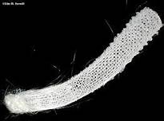
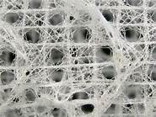
What is Euplectella sp. Skeleton?
Euplectella sp.Skeleton:
1.It is a deepwater sponge from the Western Pacific whose glassy skeleton is a hollow cylinder.
2.The structure look like intricate cagelike:20~25cm long,2~4 cm in diameter and cage is rigid.Main by silica(SiO2).
3.Its surface structure is mainly compsed of multilayered
Interwoven.
[Fig1]Venus flower basket venus flower basket,Euplectella sp.,skeketon
[Fig2] Ocean STEMulation:Sea Sponge Fiber Optics

Slide 5
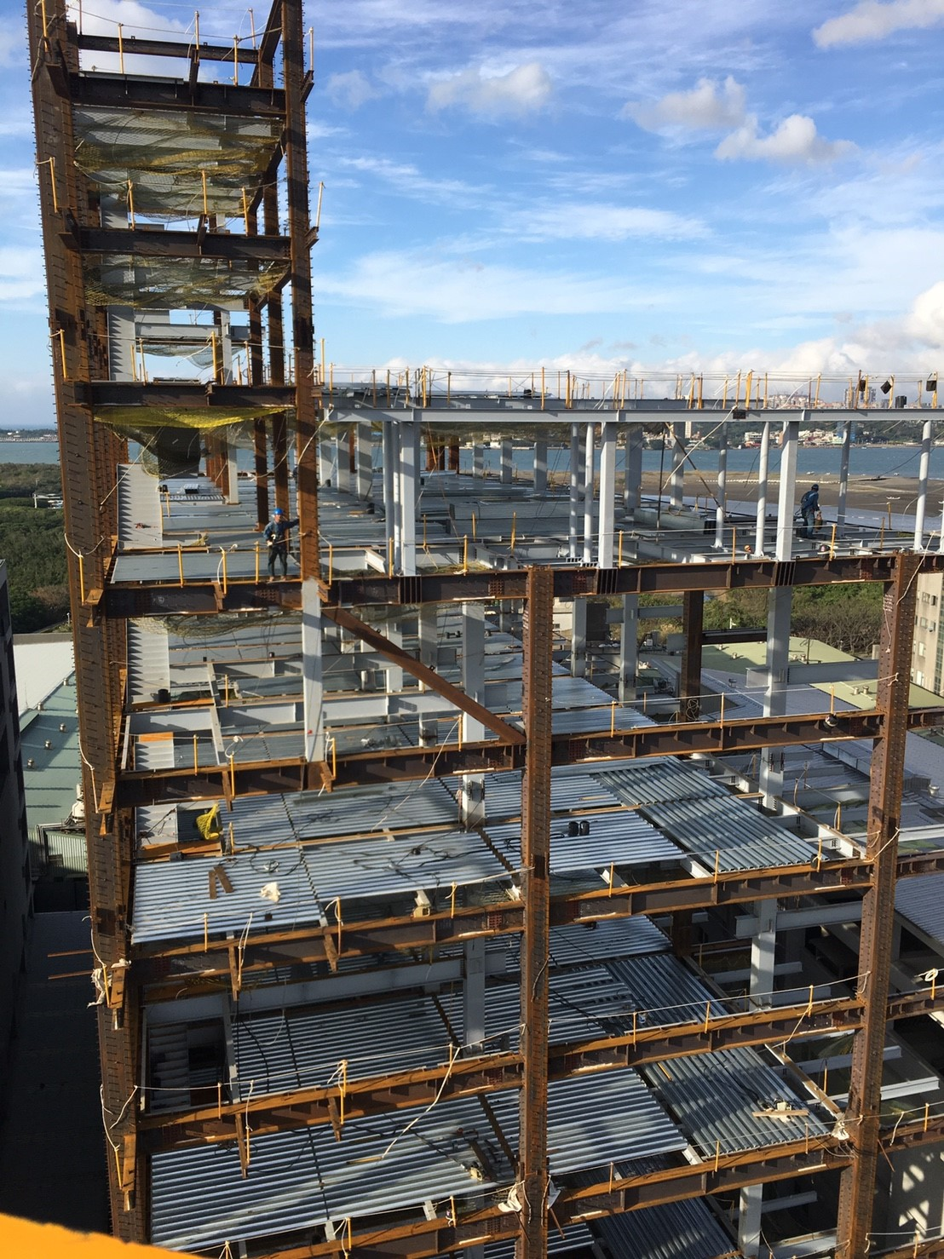
Euplectella sp. Skeleton future applications
Advanced composite materials offer the designer considerable design freedom and unique functional performance,such as low weight specific strength and stiffness,this maybe bring innovation to future building materials.
[Fig3]-大樓鋼結構.Based on www.dss.com.tw

Slide 6
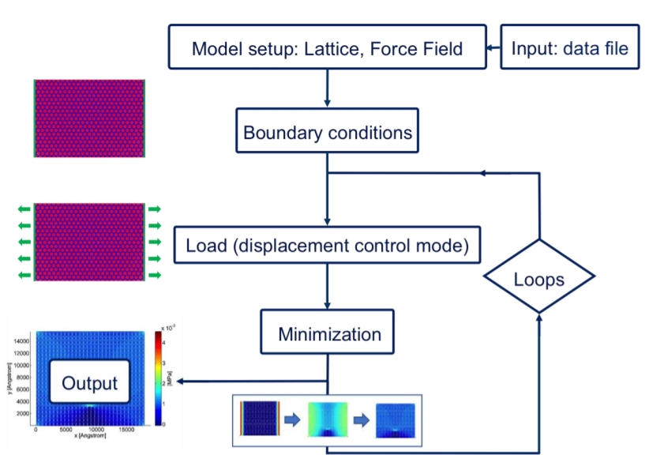
Research method
Analytical method:Lattice Spring Modeling(LSM)
Tool:Lammps,OVITO
[Fig4]MIT Buehler’s research team LSM modeling flowchart

Slide 7
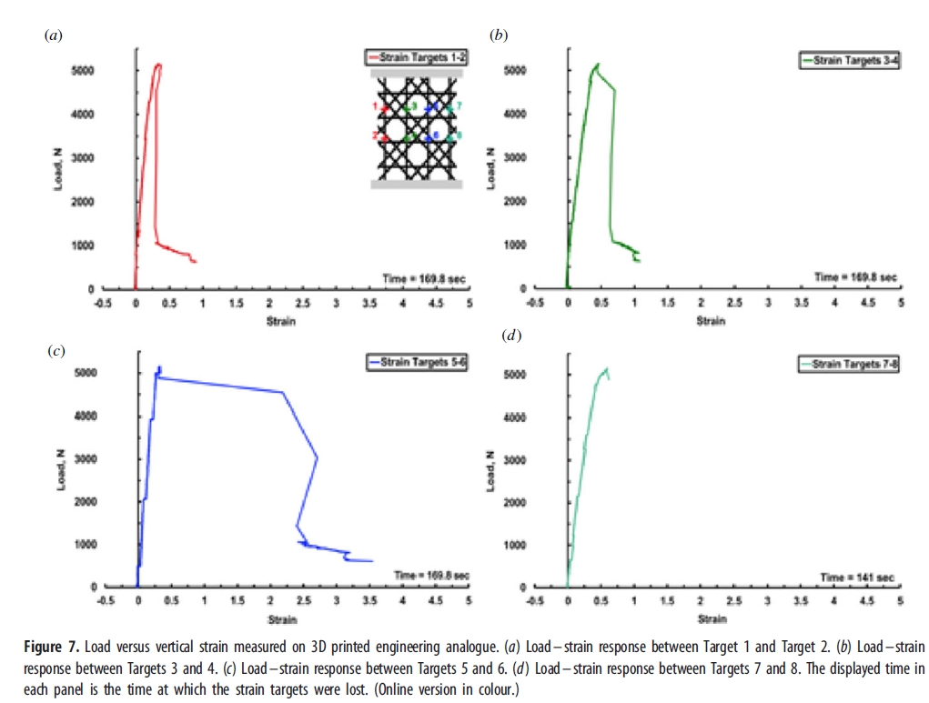
Experimental reference
K. R. Brown team find most of the stresses are concentrated at the nodes and in the middle of the beams.
Euplectella sp. Skeleton’s structure can decrease the effective length of longitudinal beams,thus preventing buckling of the latter under compressive loading.
Skeleton of E.aspergillum is charaterizedwith an elaborate hierarchical organization.The multilayered improve the local energy-absorbing capacilties.
The sub-structural design of irregular spicule-nodal point overlap imparts global strength and stiffness across the whole structure.
[Fig5] K. R. Brown,D. Bacheva,R. S. Trask 3D Printed engineering analysis

Slide 8
Simulation
Structure
Material setting

Slide 9
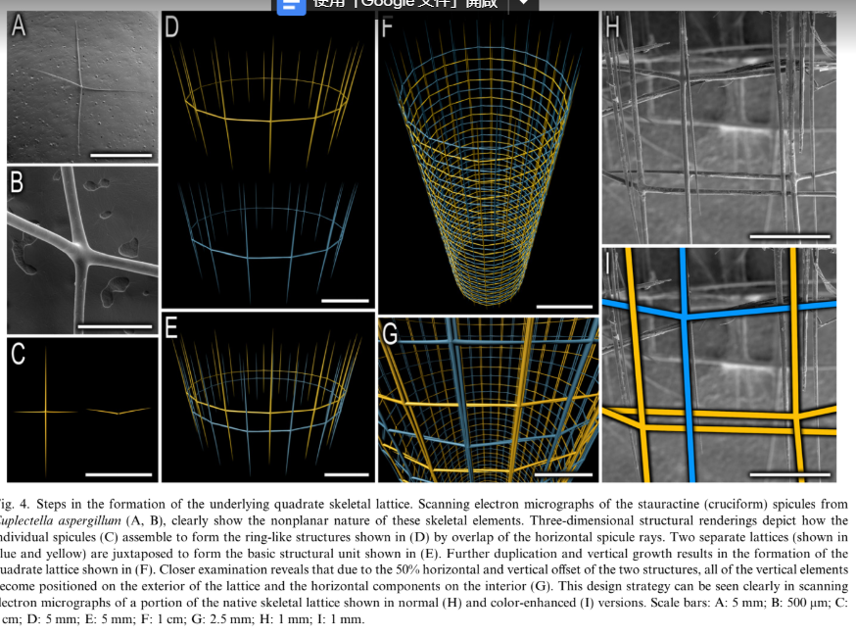
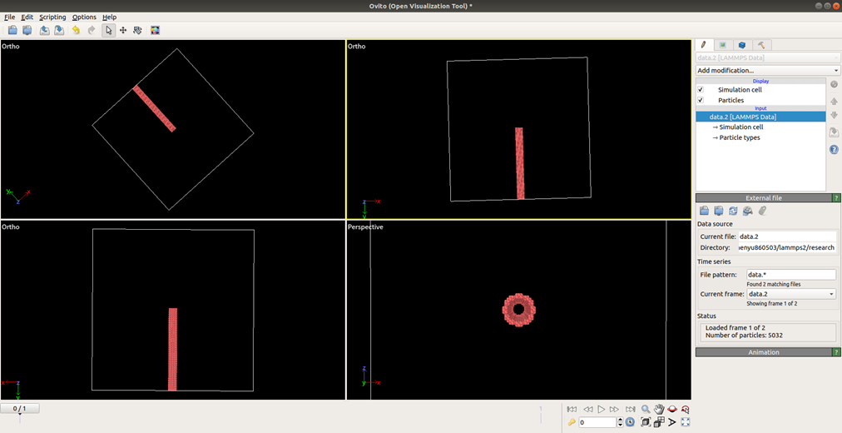
Structure
[Fig6]-ierarchical assembly of the siliceous skeletal lattice of the hexactinellid sponge Euplectella aspergillum(2006)

Slide 10
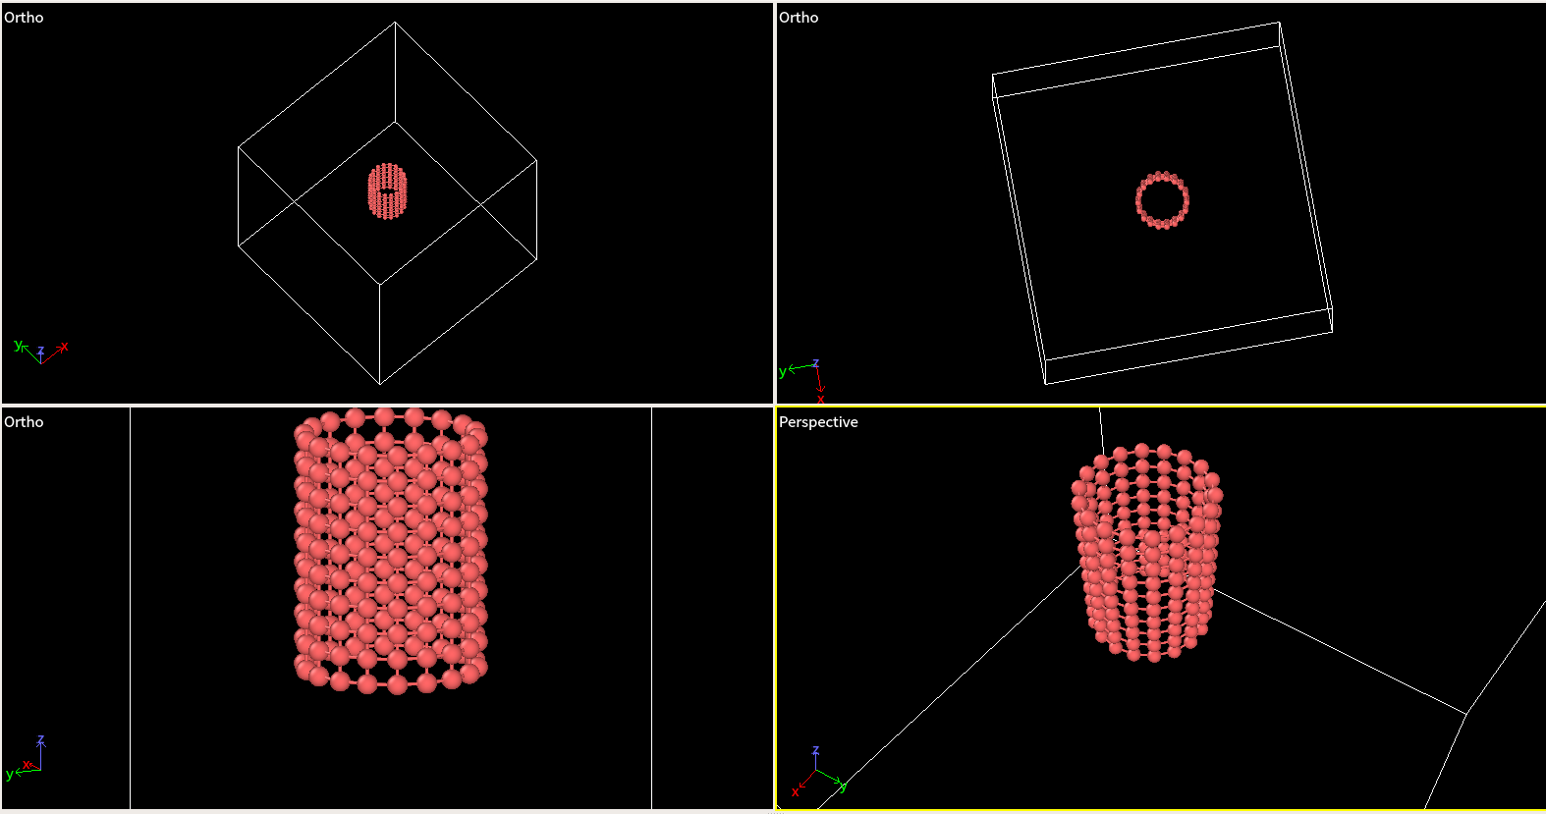
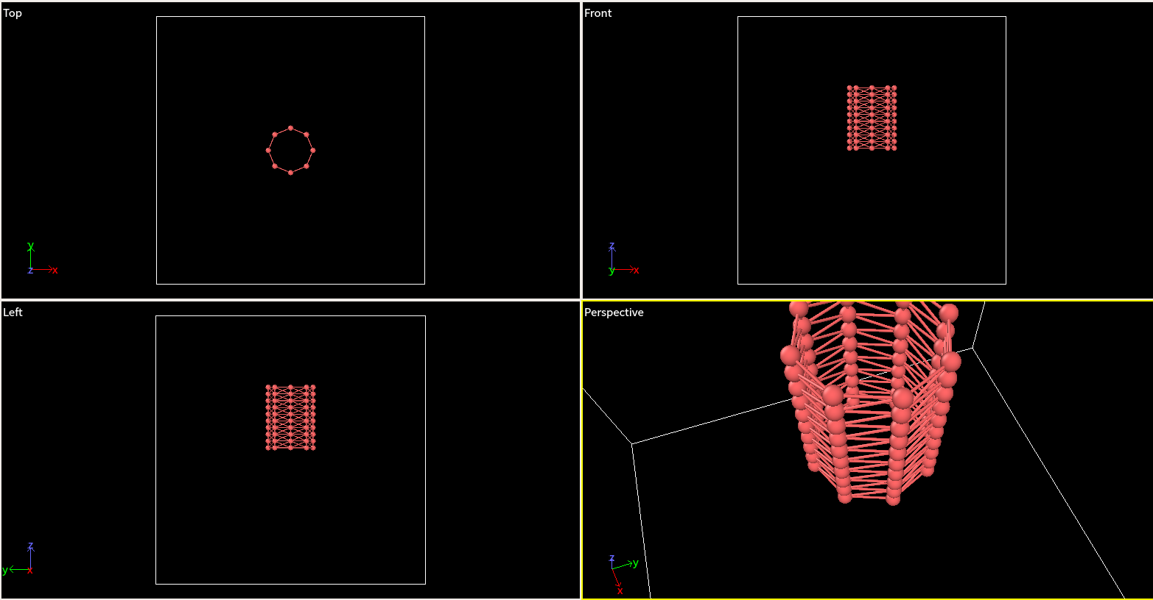
Oringinal Structure
Oringinal Structure(Slash bond)

Slide 11
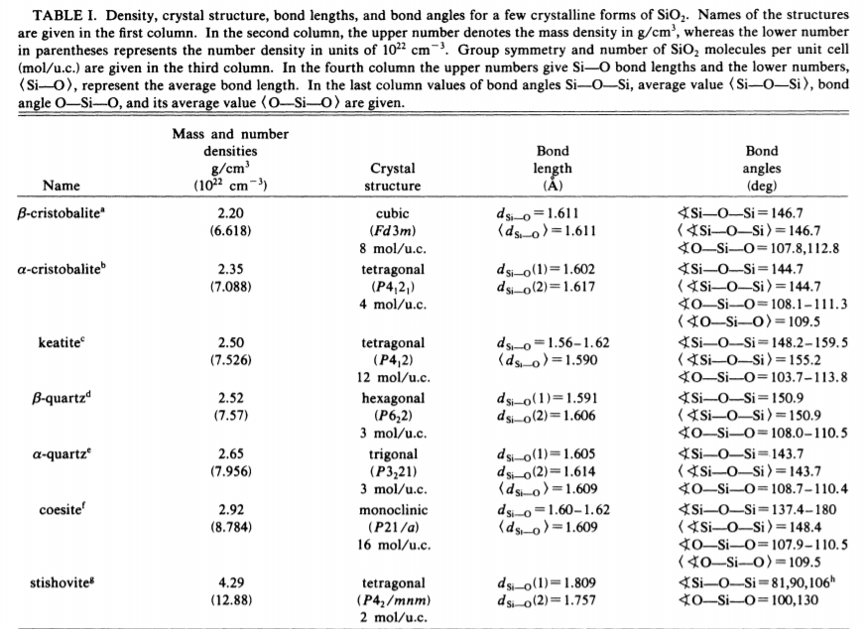
Materail Setting
[Fig7] Interaction potential for SiOz: A molecular-dynamics study of structural correlations. P. Vashishta, Rajiv K. Kalia, and Jose P. Rino

Slide 12
Future work
Build different layer structure and adjust geometric shape ratio.Observe
shape ratio and tensile strength relastionship.

Slide 13
Reference
James C. W.,Joanna A.,Georg E. F., David K.,Alexander W.,Peter A.,Kirk Fields,Michael J.P.,Frank W. Zok,Paul K. H.,Peter Fratzl., Danie.E.M., 2006.Hierarchical assembly of the siliceous skeletal lattice of the hexactinellid sponge Euplectella aspergillum.
Jianhu Shena,Yi Min Xiea,n,Xiaodong H.S.Z,Dong Ruanb., 2012.Mechanical properties of luffa sponge.
Shu-Wei Chang.,Chiu,K.M., 2019.Simulation and Analysis of Mechanical Properties for Bio-inspired Gradient Structurak Materials.
Alexander Epstein,APPHY 226,Spring 2009.Skeleton of Euplectella sp.:Strucural Hierarchy from the Nanoscale to the Macroscale
F. Libonati,V. Cipriano,L. Vergani,M.J. Buehler, computational framework to predict failure and performance of bone-inspired materials,ACS Biomaterials Science & Engineering 3 (12) (2017) 3236-3243

Slide 14
P. Vashishta, Rajiv K. Kalia, and Jose P. Rino,1990. Interaction potential for SiOz: A molecular-dynamics study of structural correlations.

